Slide 1
McDonough High School Band Program
Director of Bands: Mr. Cummings

Slide 2
Band Pathway
The band program at McDonough high school currently offers four levels of year long classes for completion of the pathway, including the following.
Beginning band
Intermediate band
Advanced band
Mastery band
Our band program is always open to new members that have the option to learn one of the following instruments.
Trumpet, French Horn, Baritone, Trombone, Tuba
Flute, Clarinet, Saxophone
And all percussion instruments (Drums)

Slide 3
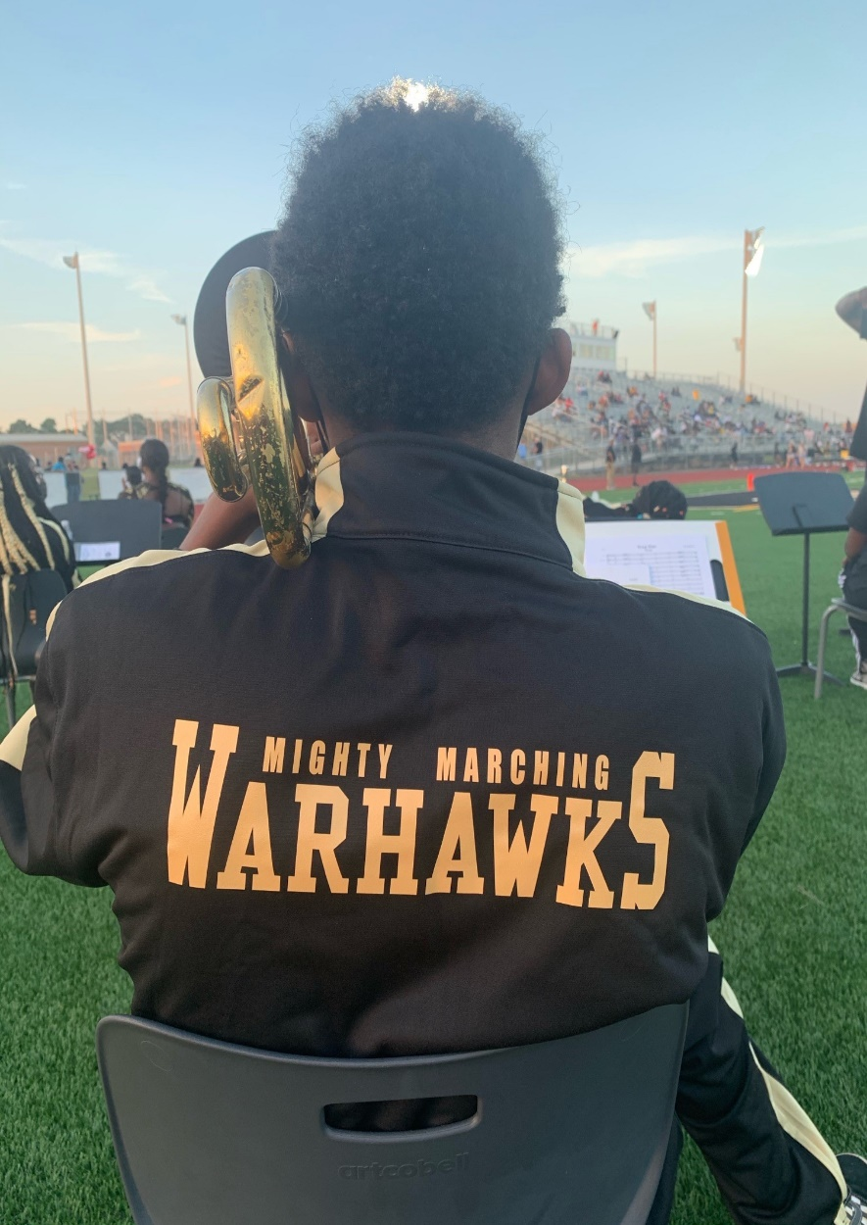
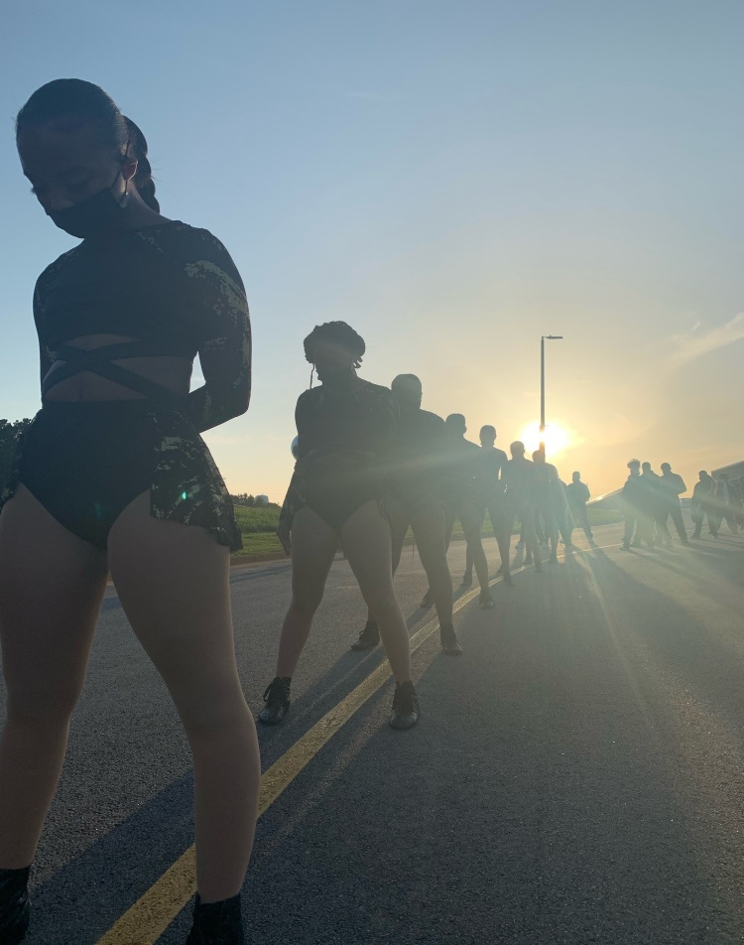
The Mighty Marching WarHawks
The marching band is the premier instrumental ensemble at McDonough High School. This ensemble participates in weekly football games, battle of the bands, marching competitions and out of state performances. This ensemble provides students the opportunity to perform for a multitude of audiences, while also providing a pathway to college and extremely abundant scholarship opportunities for students.

Slide 4
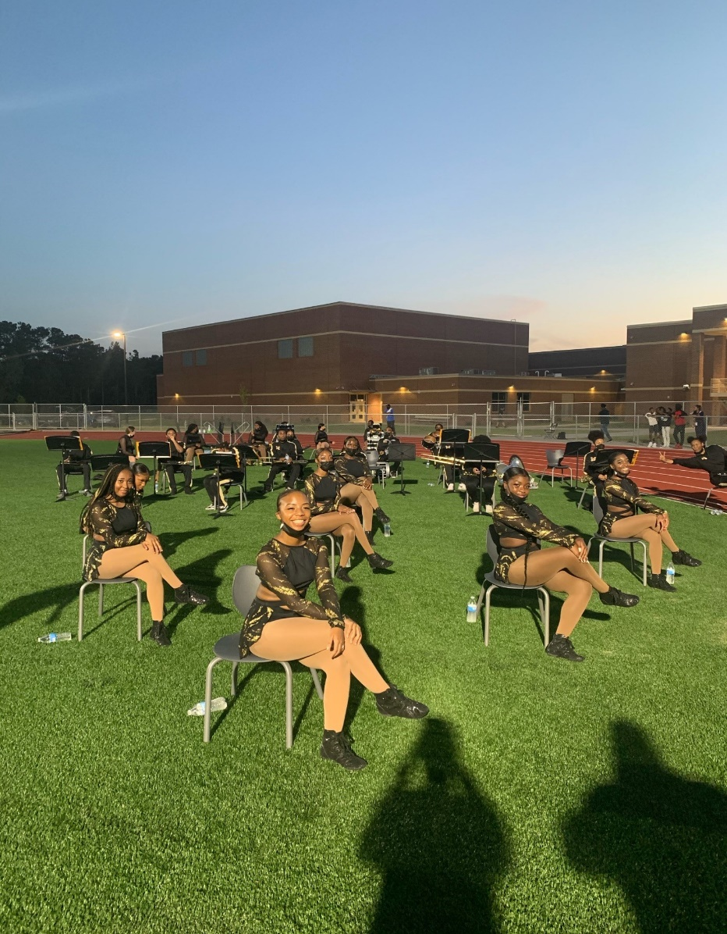
Symphonic Band
The symphonic band plays classical music and focuses heavily on instrumental fundamentals. This ensemble serves as the backbone of the band program being the ensemble that focuses most on basic technique. We participate in LGPE (large group performance evaluation) and host multiple concerts including our winter and spring concerts.

Slide 5
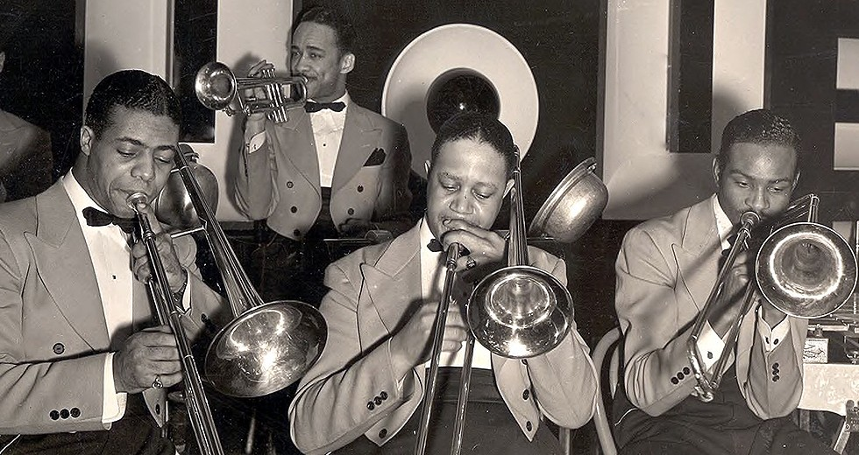
Jazz Band
The Jazz band will serve as our most advanced ensemble in the band program. Students will study different modes of scales and styles of jazz including swing, bebop, and the blues. Students will also learn the art of improvisation and learn how to create on the spot solos.

Slide 6
Benefits to joining !
Fine arts diploma seal (F.A.D.S)
Governors Honors program
All state & District honor band
GMEA & large group performance evaluation
Constructive after school activity
Traveling, performing and collegiate exposure
College Scholarship opportunities!

Slide 7
Thank you for your time !
Thank You, and we look forward to having you in our band program.

